Slide 1
Learning on Point sets
Ajad Chhatkuli
First Nepal Winter School in AI
28 December 2018

Slide 2

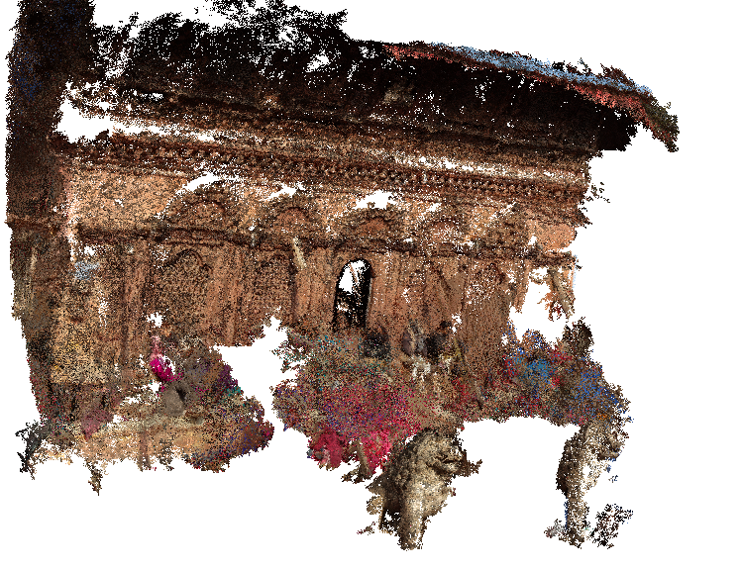
Deep Learning on Point Sets
Difference between point sets and an Image?
A 3D Point Cloud
Image

Slide 3
Points vs. Images
Point set => No particular order of points in a set
Examples: User data for a business
-1 | 2
2 | 3
9 | -5
120 | 240

Slide 4
Convolution
Convolution results depend on the order
1 | 3 | 5 | 1 | 9 | 2
4 | 5 | 1 | 7 | 8 | 2
3 | 5 | 1 | 3 | 4 | 3
4 | 2 | 2 | 2 | 2 | 2
3 | 4 | 5 | 6 | 2 | 4
1 | 2 | 1 | 1 | 1 | 1
-1 | 0 | 1
-2 | 0 | 2
-1 | 0 | 1
*

Slide 5
Order dependence
Convolution results depend on the order
1 | 3 | 5 | 1 | 9 | 2
4 | 5 | 1 | 7 | 8 | 2
3 | 5 | 1 | 3 | 4 | 3
4 | 2 | 2 | 2 | 2 | 2
3 | 4 | 5 | 6 | 2 | 4
1 | 2 | 1 | 1 | 1 | 1
-1 | 0 | 1
-2 | 0 | 2
-1 | 0 | 1
*

Slide 6
Think about order invariance
How do you learn permutation invariant features?
1 | 3 | 1 | 5 | 9 | 2
4 | 5 | 7 | 1 | 8 | 2
3 | 5 | 3 | 1 | 4 | 3
4 | 2 | 2 | 2 | 2 | 2
3 | 4 | 6 | 5 | 2 | 4
1 | 2 | 1 | 1 | 1 | 1
-1 | 0 | 1
-2 | 0 | 2
-1 | 0 | 1
*

Slide 7
1 X 1 convolution
Check order invariance
1 | 3 | 5 | 1 | 9 | 2
4 | 5 | 1 | 7 | 8 | 2
3 | 5 | 1 | 3 | 4 | 3
4 | 2 | 2 | 2 | 2 | 2
3 | 4 | 5 | 6 | 2 | 4
1 | 2 | 1 | 1 | 1 | 1
*
2

Slide 8
A more practical case
Consider F1 feature maps as input to a F 1x1 conv filter
F number of 1 X 1 X F1
F1
F

Slide 9
Deep Learning on Point Sets
ReLU and Max pooling
Max Pool
F number of 1 X 1 X F1
F1
F
F
n
n
1

Slide 10
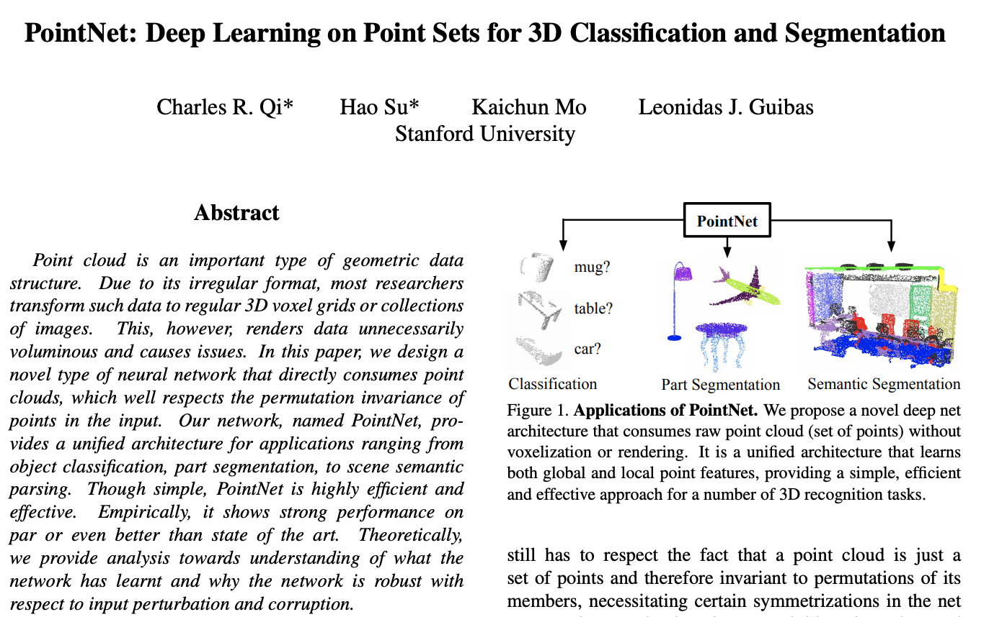
PointNet [Qi et al., 2017]

Slide 11
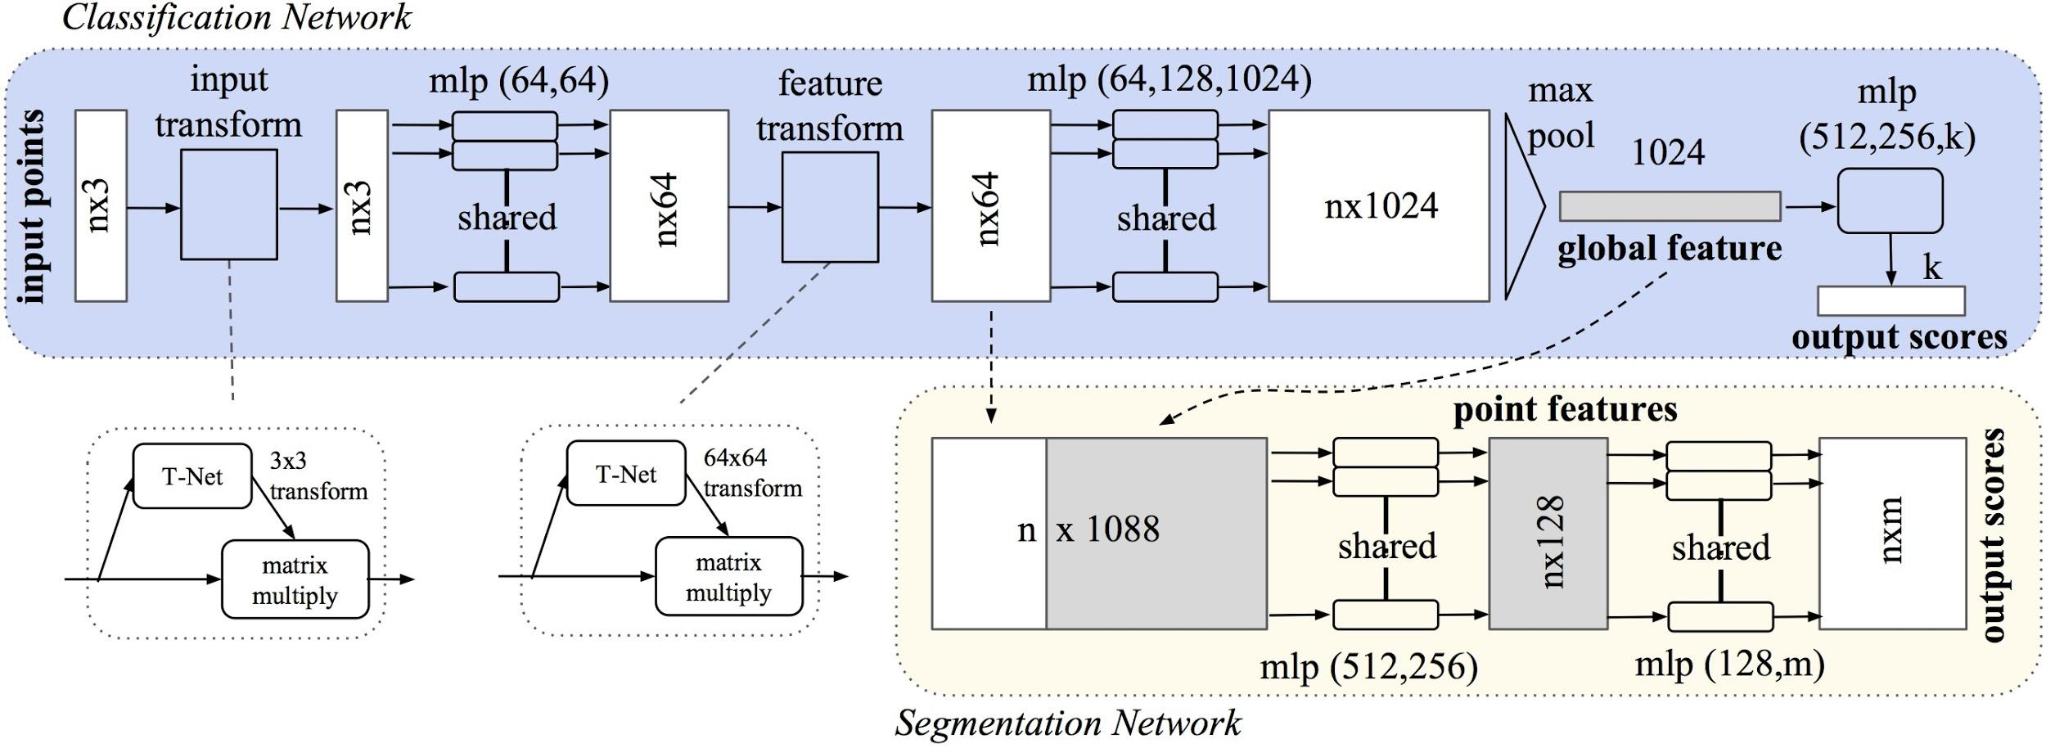
PointNet Architecture
1x1 Conv, ReLU and Max pooling

Slide 12
Inputs to the Network
Input is a set of vectors
Examples: Point cloud, Mesh, Corresponding points, User data
Point cloud: 3 x n
Length of the set: n

Slide 13
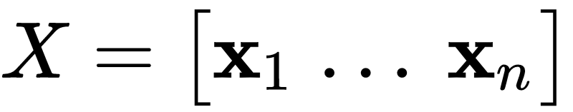
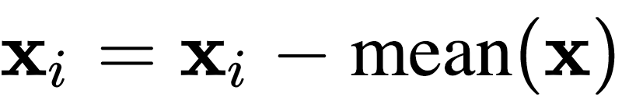
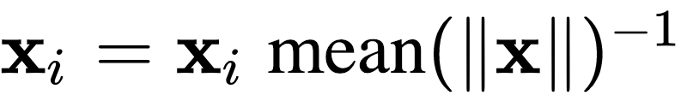
Inputs to the Network
Some basic preprocessing:
Vector scale, centering

Slide 14
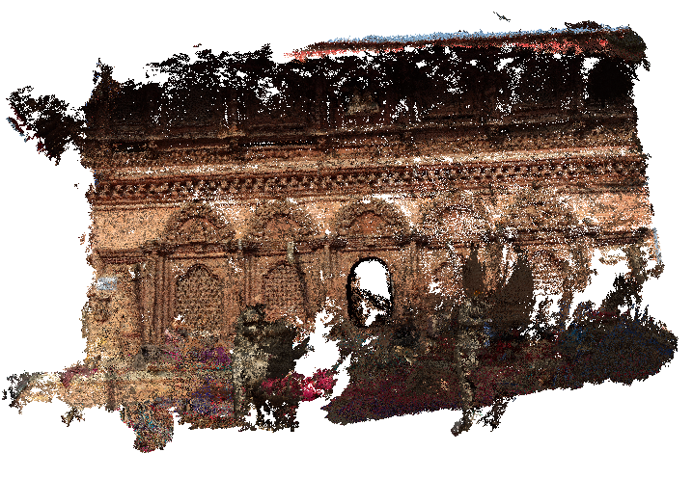
Canonical Alignment for 3D Points
More invariance: Rotation ` `
Examples: Point cloud, Mesh, Corresponding points, User data

Slide 15
Canonical Alignment for 3D Points
More invariance: Rotation ` `
Examples: Point cloud, Mesh, Corresponding points, User data

Slide 16
High Dimensional Embedding
1x1 Conv with 32, 64, 128 filters
Dimensionality change

Slide 17
Max pool operation
1x1 Conv with 32, 64, 128 filters
Summarizes the points

Slide 18
Final feature vectors
Global feature vector
Can be combined with point-wise features

Slide 19
3D Vision
Pixel location to pixel location relation
The Fundamental Matrix

Slide 20
Mapping Pixel Locations
Transfer pixel from one image to another
Example panaroma images

Slide 21


Pixel Locations
How do you relate pixel locations between two images?
Homography

Slide 22
Pixel Locations
How do you relate pixel locations between two images?
Homography

Slide 23
Quiz
At what condition SGD will approach GD?

